Slide 1

EFFICIENT LOG DATA MANAGEMENT WITH KQL: WRITING AZURE QUERIES FOR LOG ANALYTICS WORKSPACE
By :
P.DEEPTHI
G.KAVYA
K.HARI PRIYA YADAV
U.KIRAN KUMAR
D.MEERAVALI
19JU1A0513
19JU1A0533
19JU1A0526
19JU1A0538
19JU1A0553
Under the guide of :
Mrs.A.AMRUTAVALLI M.TECH,(Ph.D)
Assoc., Professor
DEPARTMENT OF COMPUTER SCIENCE AND ENGINEERING
KRISHNA CHAITANYA INSTITUTE OF TECHNOLOGY AND SCIENCES
(Approved by AICTE,New Delhi & Affiliated to JNTU,KAKINADA)
MARKAPUR
2022-2023

Slide 2
CONTENTS
ABSTRACT
INTRODUCTION
LITERATURE REVIEW
EXISTING SYSTEM
DRAWBACKS OF EXISTING SYSTEM
PROPOSED SYSTEM
ADVANTAGES OF PROPOSED SYSTEM
REQUIREMENT SPECIFICATION
AGENT DEPLOYMENET
CONCLUSION
REFERENCES

Slide 3
Abstract
Efficient Log Data Management with KQL: Writing Azure Queries for Log Analytics Workspace is a project that focuses on using the Kusto Query Language (KQL) for efficient log data management in Azure Log Analytics Workspace. This project explores the importance of log data management, the challenges faced in managing log data, and how KQL can be leveraged to write queries for efficient log data analysis.
The project provides a step-by-step guide on how to write Azure queries using KQL for log data management. It covers topics such as data ingestion, creating custom logs, and data visualization using KQL queries.
The project will be beneficial to IT professionals, cloud administrators, and anyone interested in learning how to effectively manage log data using KQL in Azure Log Analytics Workspace.

Slide 4
INTRODUCTION
With the growing number of applications, systems, and devices in use today, it has become essential to monitor and manage log data effectively. Azure Log Analytics Workspace is a cloud-based log management solution that provides a centralized platform for collecting, analyzing, and visualizing log data from various sources. It offers advanced features such as log search, log analytics, and custom queries, which can help organizations gain insights into their log data and identify potential issues.
The objective of this project is to explore and analyze Azure Log Analytics Workspace and develop efficient queries for log data management.
The success of this project will be evaluated based on the efficiency and effectiveness of the developed queries for log data management.

Slide 5
Literature review
There are several advantages to deploying resources in the Azure cloud compared to on-premises infrastructure. The following literature review summarizes some of the key advantages of Azure cloud deployment with references to support these claims:
Scalability and Flexibility: One of the most significant advantages of Azure cloud deployment is scalability and flexibility. Azure allows organizations to quickly scale up or down their resources based on demand without having to invest in additional hardware. According to Forrester. (2020), Azure's ability to scale on demand and offer flexible pricing models provides significant benefits for businesses.
Disaster Recovery and Business Continuity: Azure cloud deployment provides businesses with robust disaster recovery and business continuity capabilities. According to a study by Synergy Research Group (2021), Azure has one of the highest uptime rates among cloud providers, offering businesses reliable access to their resources and applications.

Slide 6
EXISTING SYSTEM
KQL (Kusto Query Language) is a query language developed by Microsoft for analyzing large volumes of data in real-time. KQL is the language used by Azure Data Explorer, which is a fast and scalable data analytics service provided by Microsoft.
Azure Data Explorer provides a fully managed service for ingesting, storing, and querying large amounts of data. It supports data from a variety of sources, including logs, telemetry data, and other structured data. KQL is used to query this data and extract insights.

Slide 7
DISADVANTAGES
Requires Internet Access: KQL is a cloud-based service, which means that users must have internet access to use it. This could be an issue for users who need to work with data offline or in areas with limited internet connectivit
Vendor Lock-In: KQL is a proprietary language developed by Microsoft, which means that users who rely on KQL may be locked into using Microsoft's products and services.
Cost: KQL is a paid service, and users must pay for the amount of data they store and the number of queries they run. This could be a concern for users with large datasets or limited budgets.

Slide 8
PROPOSED SYSTEM
As far as I know, KQL (Kusto Query Language) is a mature and established query language used in Azure Data Explorer, which is a fast and scalable data analytics service provided by Microsoft. As such, there may not be a specific "proposed system" for KQL. However, there are ongoing efforts to enhance the capabilities and features of KQL to better serve the needs of users.
Overall, the future development of KQL will likely focus on enhancing its capabilities and features to better serve the needs of users and keep up with changing trends in data analysis and management.
Improved Data Visualization: While KQL already supports data visualization through integrations with tools like Power BI, there is always room for improvement in terms of making data visualization more intuitive and user-friendly.

Slide 9
DATA FLOW DIAGRAM :
Portal Login
Create Virtual Machine
Log Analytics Workspace Login
Agent Download
Windows path created
Apply KQL queries in Log

Slide 10
ADVANTAGES
Simple Syntax: KQL uses a simple syntax that is easy to learn and use. Its syntax is similar to SQL, which makes it familiar to users who have experience with SQL.
Query Performance: KQL is designed to be highly performant and can handle large datasets. It uses a columnar data store that allows for efficient processing of data.
Real-time Data Analysis: KQL is optimized for real-time data analysis and can be used to analyze data as it is generated. This makes it ideal for monitoring and alerting systems.
Flexibility: KQL is a versatile language that can be used to query a wide range of data sources. It can be used to query data stored in Azure Data Explorer, Azure Log Analytics, Azure Monitor, and other data sources.

Slide 11
SYSTEM REQUIREMENTS
HARDWARE REQUIREMENTS
RAM : minimum 4 GB
Space on Hard Disk : minimum 18 GB
Processor : Core i3 or i5
High speed internet : 5mbps
OPERATING SYSTEMS SUPPORTED
Windows 7 or above
SOFTWARE REQUIREMENTS
Microsoft Azure in cloud

Slide 12
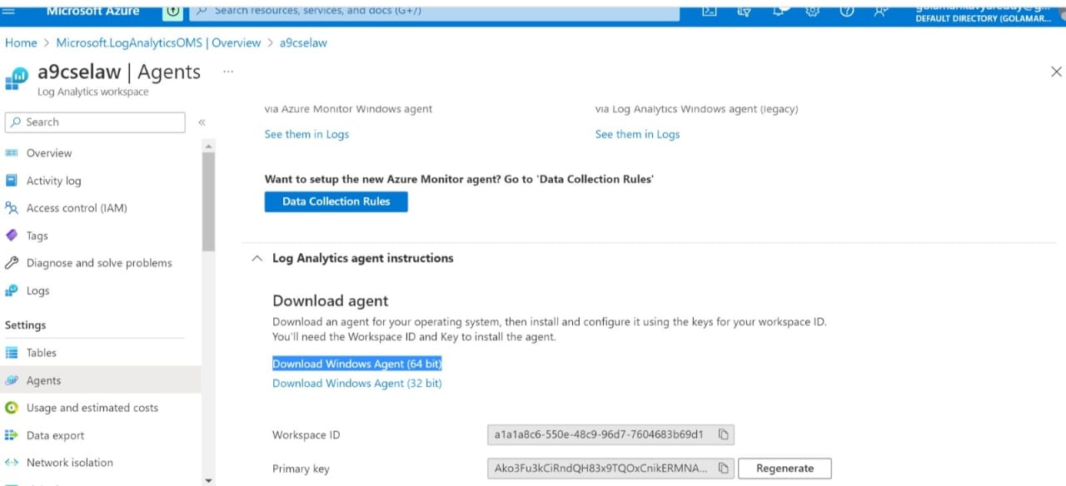
AGENT deployment
Select the workspace from the Log Analytics workspaces menu in the Azure portal. Then in the Settings section, select Agents.

Slide 13
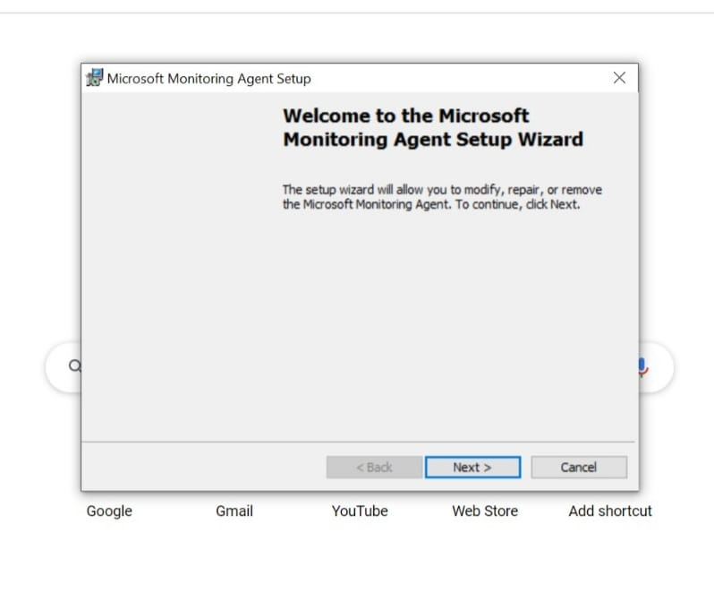
select the appropriate Download Windows Agent version to download depending on the processor architecture of the Windows operating system.
Run Setup to install the agent on your computer.

Slide 14
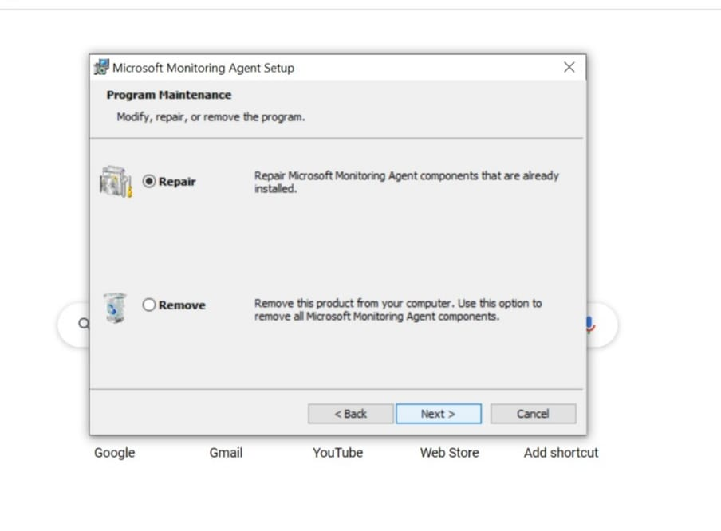
On the Welcome page, click Next.
On the Destination Folder page, change or keep the default installation folder and then click Next.

Slide 15
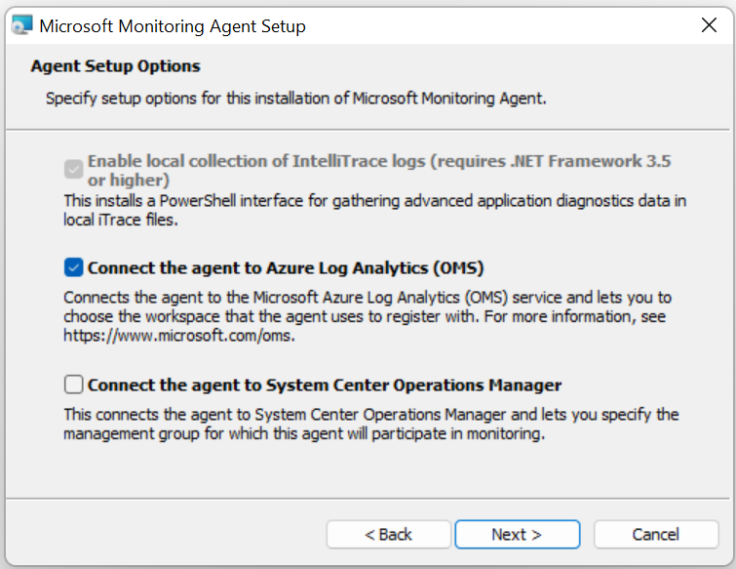
On the Agent Setup Options page, choose to connect the agent to Azure Log Analytics and then click Next.

Slide 16
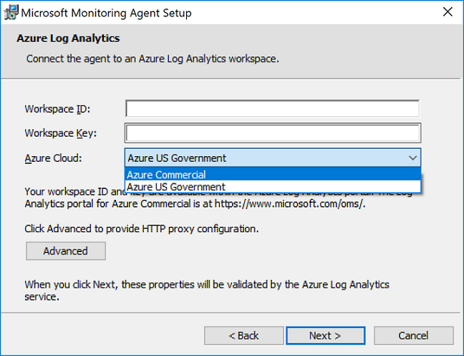
Paste the Workspace ID and Workspace Key (Primary Key) that you copied earlier. If the computer should report to a Log Analytics workspace in Azure Government cloud, select Azure US Government from the Azure Cloud drop-down list.

Slide 17
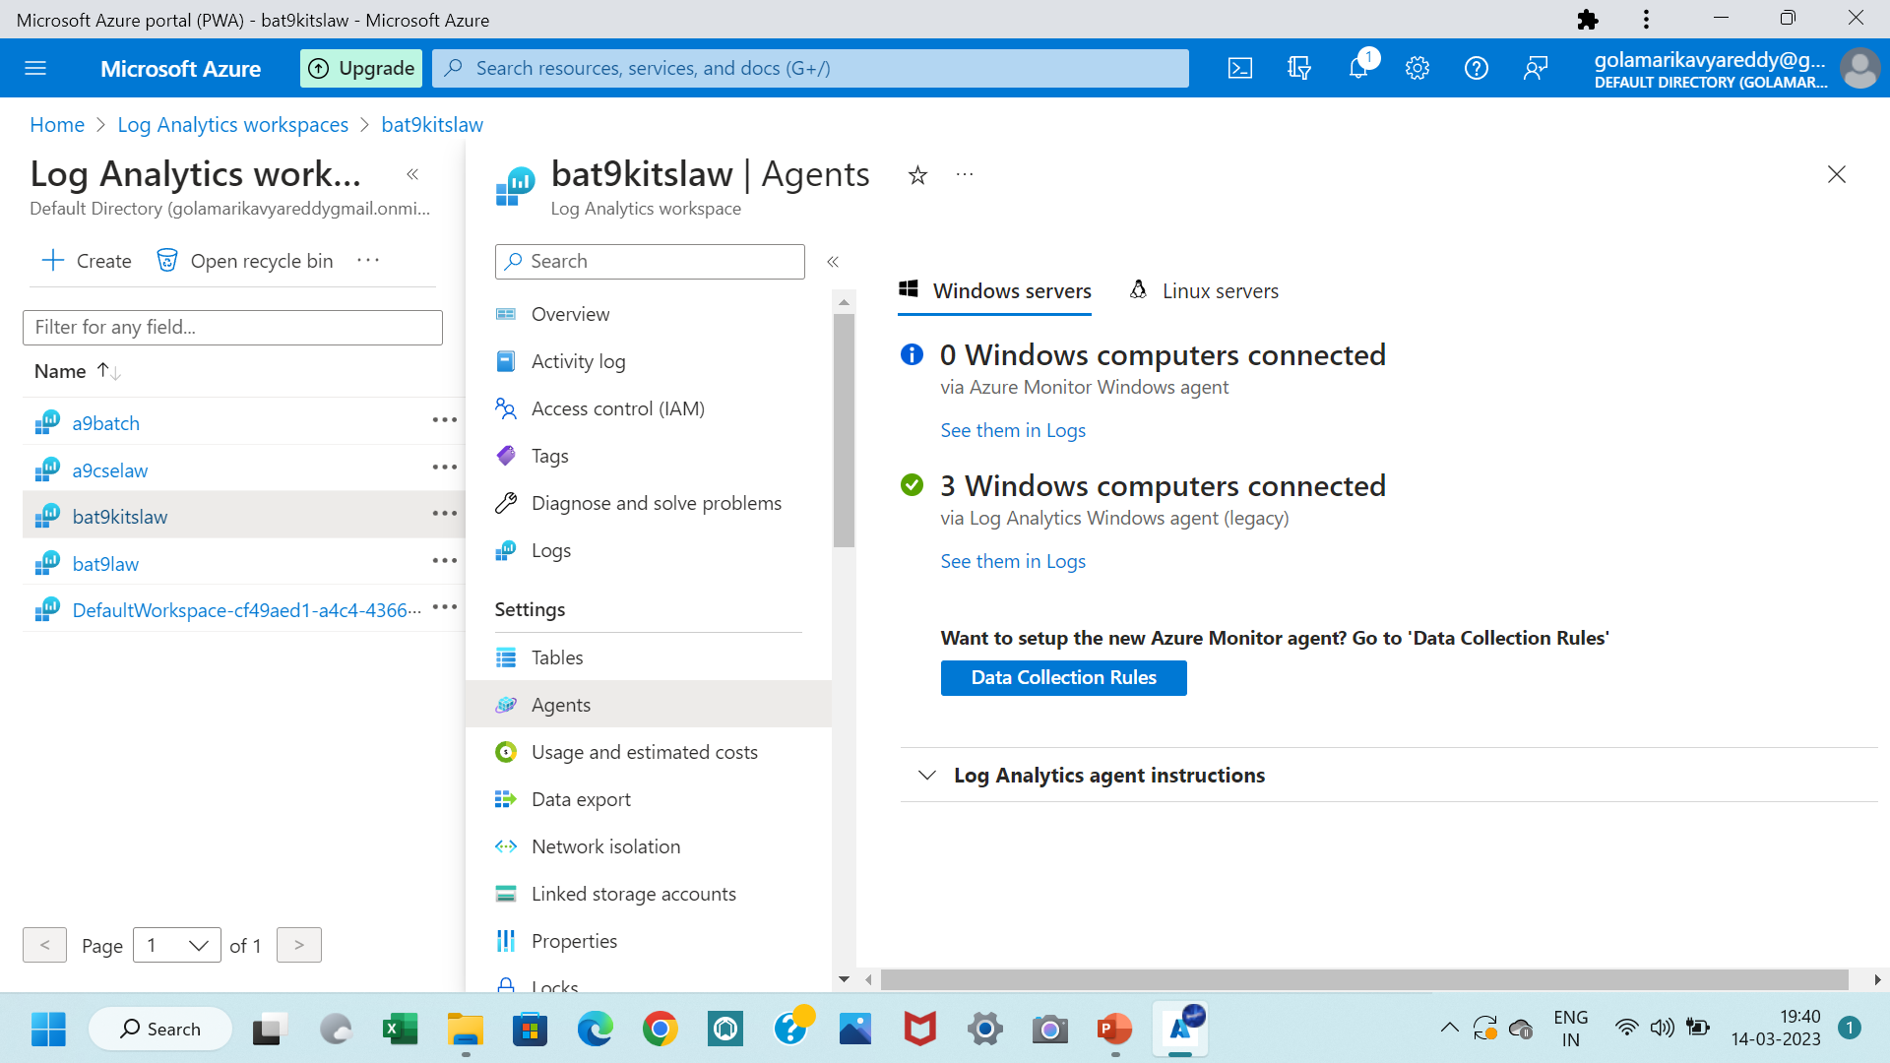
Click Next once you have completed providing the necessary configuration settings.

Slide 18
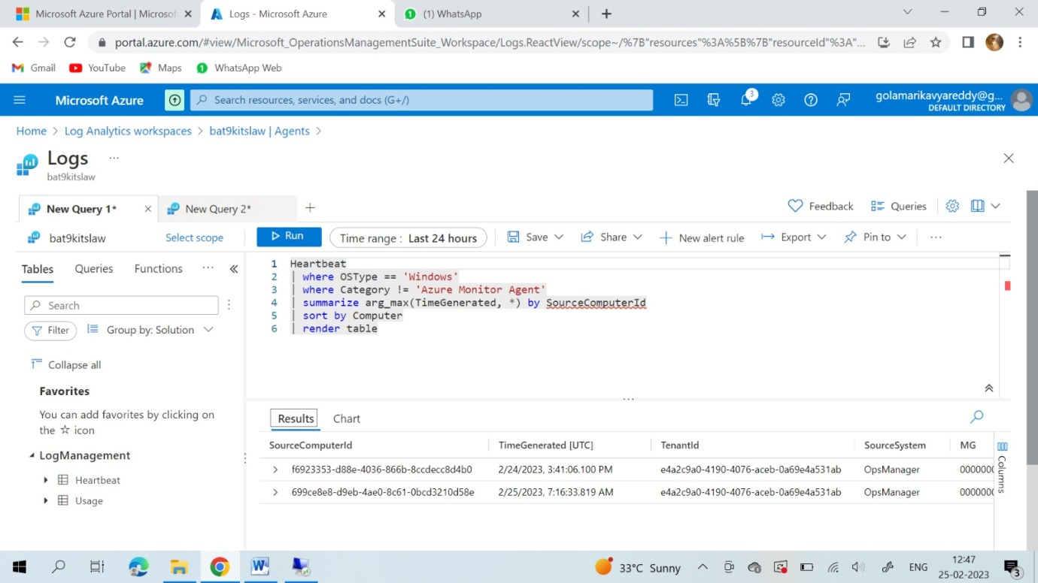
KQL Query –1:
Heartbeat
| where OSType == ‘Windows’
| where Category != ‘Azure Monitor Agent’
| summarize arg_max(TimeGenerated, *) by SourceComputerId
| sort by Computer
| render table

Slide 19
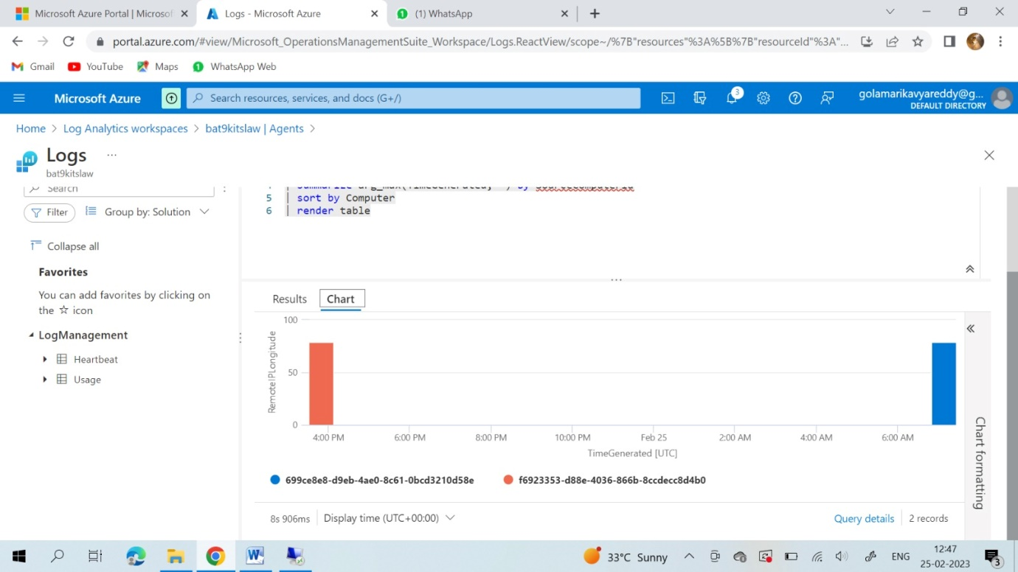

Slide 20
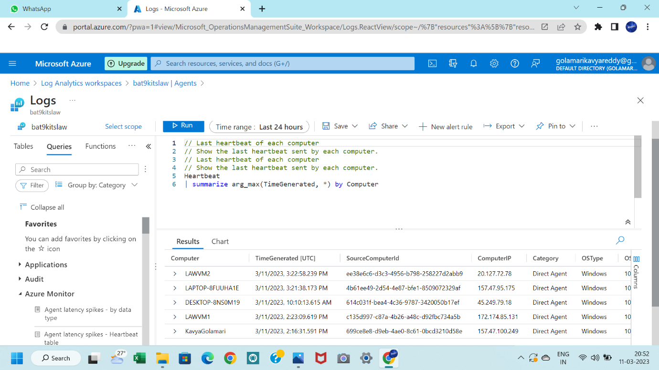
KQL Query –2:
Heartbeat
| summarize arg_max(TimeGenerated, *) by Computer

Slide 21
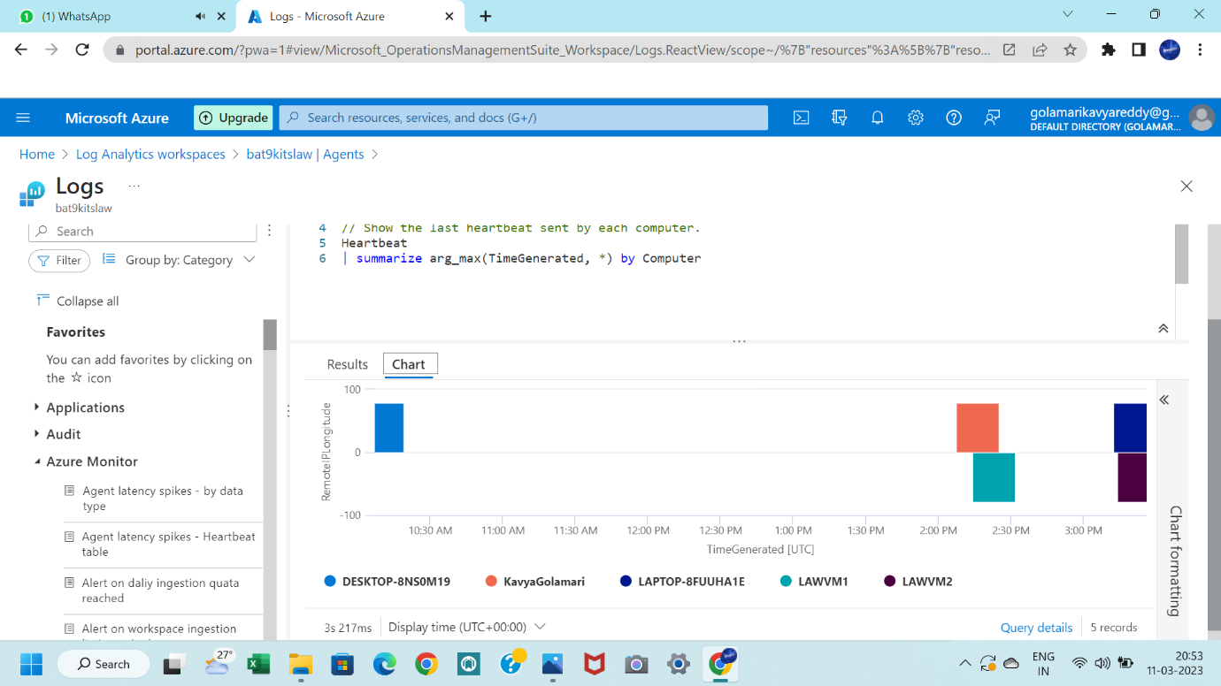

Slide 22
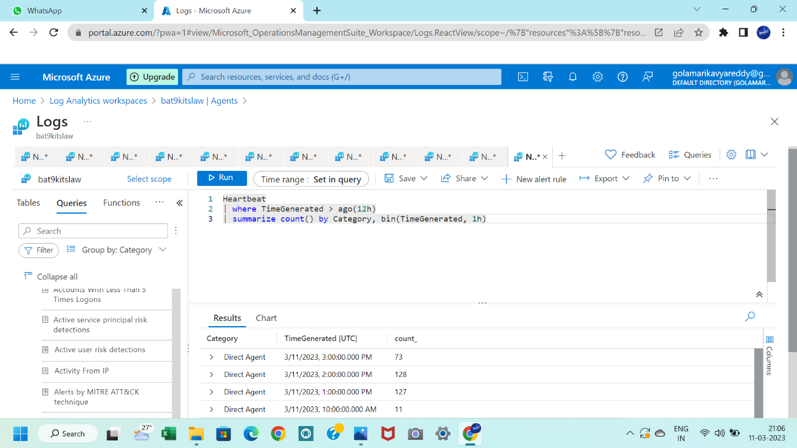
KQL Query –3:
Heartbeat
| where TimeGenerated > ago(12h)
| summerize count() by Category, bin(TimeGenerated, 1h)

Slide 23
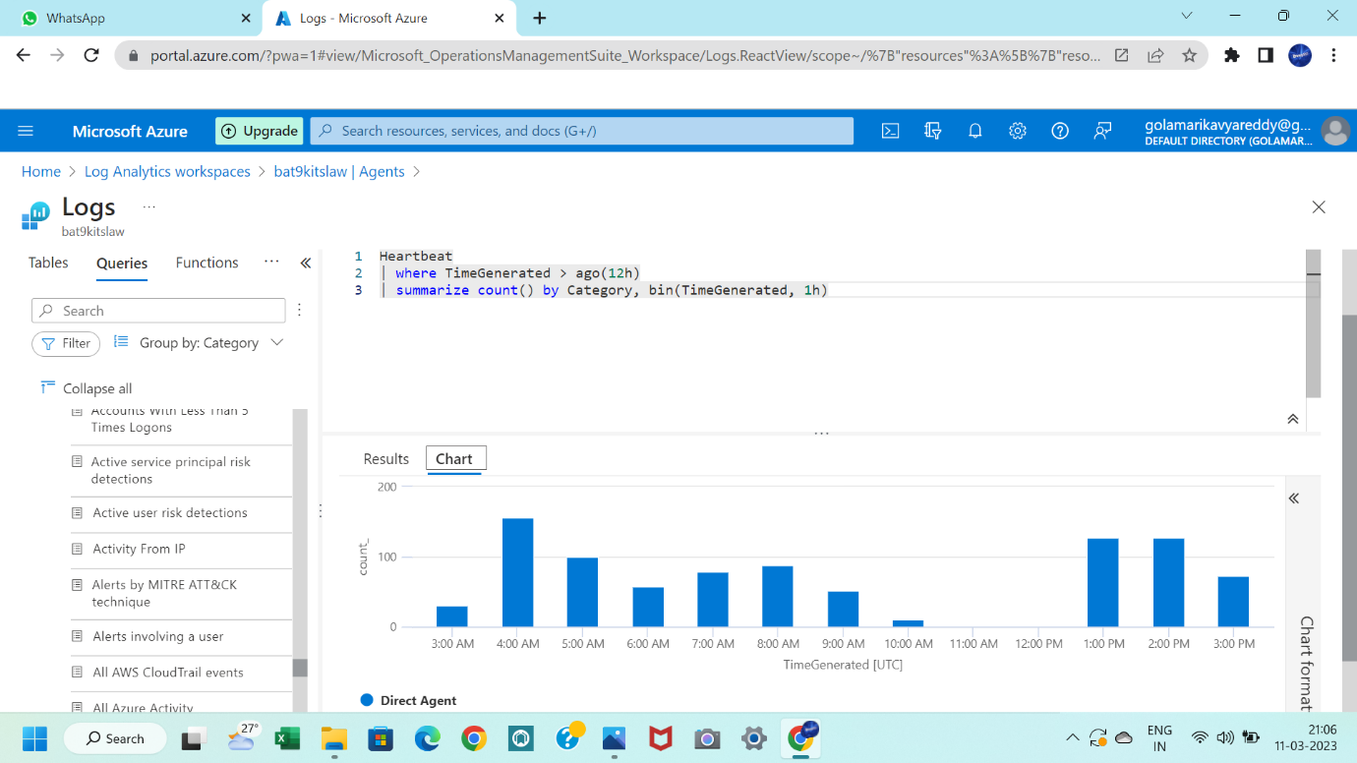

Slide 24
conclusion
In conclusion, the exploration and analysis of Azure Log Analytics Workspace for developing efficient queries for log data management is a critical step in achieving effective IT infrastructure management. This project has demonstrated the importance of log analytics and the role it plays in monitoring and troubleshooting IT infrastructure.
By utilizing the strategies and techniques outlined in this project, organizations can enhance the efficiency and effectiveness of their IT infrastructure management and deliver better business outcomes. With Azure Log Analytics Workspace, organizations can easily manage and analyze their log data, monitor the health of their IT infrastructure, and troubleshoot issues in real-time, thereby reducing downtime and improving overall operational efficiency.

Slide 25
REFERENCES
Forrester. (2020). The Total Economic Impact™ Of Microsoft Azure. Retrieved from https://www.forrester.com/report/The+Total+Economic+Impact+Of+Microsoft+Azure/-/E-RES156568
Synergy Research Group. (2021). Microsoft Azure achieves high uptime rate in Q4. Retrieved from https://www.srgresearch.com/articles/microsoft-azure-achieves-high-uptime-rate-q4

Slide 26


